Slide 1
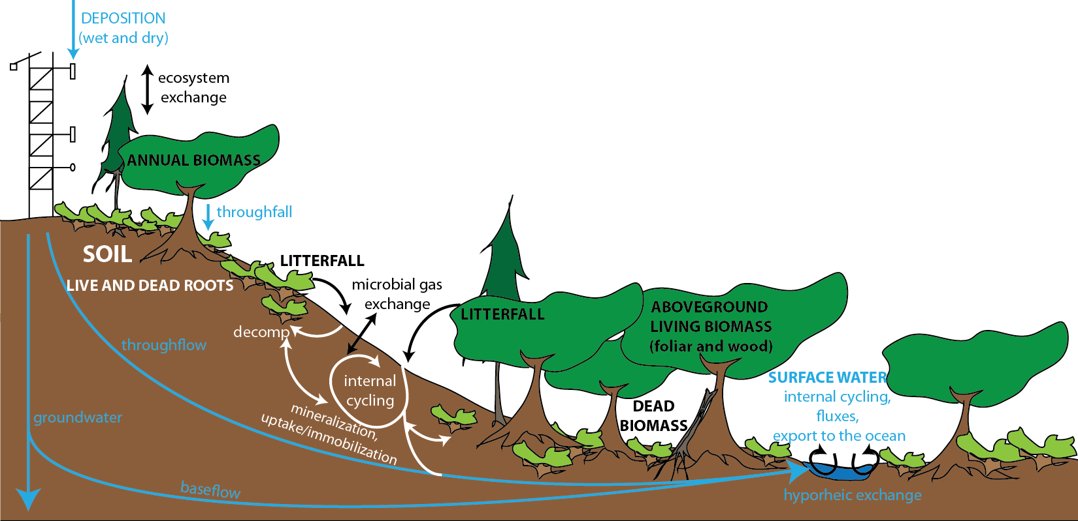
NEON plant, soil, and microbial sampling design
Eve-Lyn S. Hinckley, Courtney Meier, and Jacob Parnell, The National Ecological Observatory Network
An integrated biogeochemistry sampling plan across systems
NEON’s 30-year sampling strategy for monitoring ecosystem productivity and biogeochemistry includes co-located measurements of plant structure, biomass, soil and plant biogeochemistry, and microbial populations. The resulting data can be used to address a wide variety of questions related to ecosystem science. This overview focuses on the measurements associated with two specific components of this design: soil biogeochemistry and microbial diversity (page 2), and plant structure and biogeochemistry (page 3). Scaling point measurements of these ecosystem components across space relies heavily on NEON’s Airborne Observation Platform (AOP), which will fly over all NEON sites annually to collect LiDAR and hyperspectral data, as well as high-resolution aerial images. These data will be used with ground-based measurements of plant structure and foliar chemistry to create site-scale surfaces of canopy height, plant canopy water content, foliar C, N, and other chemical constituents.

Slide 2
NEON soil biogeochemistry and microbial diversity design
Microorganisms are critical drivers of biogeochemical processes that influence global climate, water quality, and atmospheric composition (Vitousek et al., 1997). Consequently, measuring soil microbes and soil biogeochemistry is central to NEON’s success.
One soil core will be collected in three of the four subplots per plot for a total of three soil cores per plot per sampling event.
Measurement | Frequency | Output
16S rRNA sequencing | 1-3x per y | Richness, evenness, OTU tables
ITS rRNA sequencing | 1-3x per y | Richness, evenness
Shotgun metagenomics | Annually | Potential functional diversity
Shotgun metatranscriptomics | Annually | Active functional diversity
16S rRNA qPCR | 1-3x per y | Bacterial/archaeal abundances
ITS rRNA qPCR | 1-3x per y | Fungal abundances
Microbial biomass | Every 3-5 y | Soil microbial biomass
Microbial Measurements
Organic soils are collected as square “brownies”
Measurement | Frequency
Texture | Once
Bulk density | Once
Organic horizon | Once
Total C | Every 10 y
Total N | Every 10 y
Total P | Every 10 y
Total S | Every 10 y
Organic C | Every 10 y
Cations and anions | Every 10 y
pH | 3x per y
C and N stable isotopes | Every 10 y
Inorganic N | 3x every 5 y
P fractions | Every 10 y
Net nitrification | 3x every 5 y
Net N mineralization | 3x every 5 y
Organic C fractions | Every 10 y
Temperature | Every soil sampling event
Moisture | Every soil sampling event
Biogeochemical Measurements
Mineral soils are collected with a coring device
20x20m subplot
40m
In order to adequately measure microbial diversity, function, and soil biogeochemistry, soil samples will be collected from up to 20 tower and distributed plots (above; see spatial design handout). Soil sampling plots are co-located with plant diversity measurements (green areas) and tissue chemistry to maximize associated measurements.
All NEON data will be made publicly available via a web portal following initial QA/QC
Vitousek, P.M., H.A. Mooney, J. Lubchenco, and J.M. Melillo. 1997. Human domination of Earth’s ecosystems. Science 277(5325): 494-499.

Slide 3
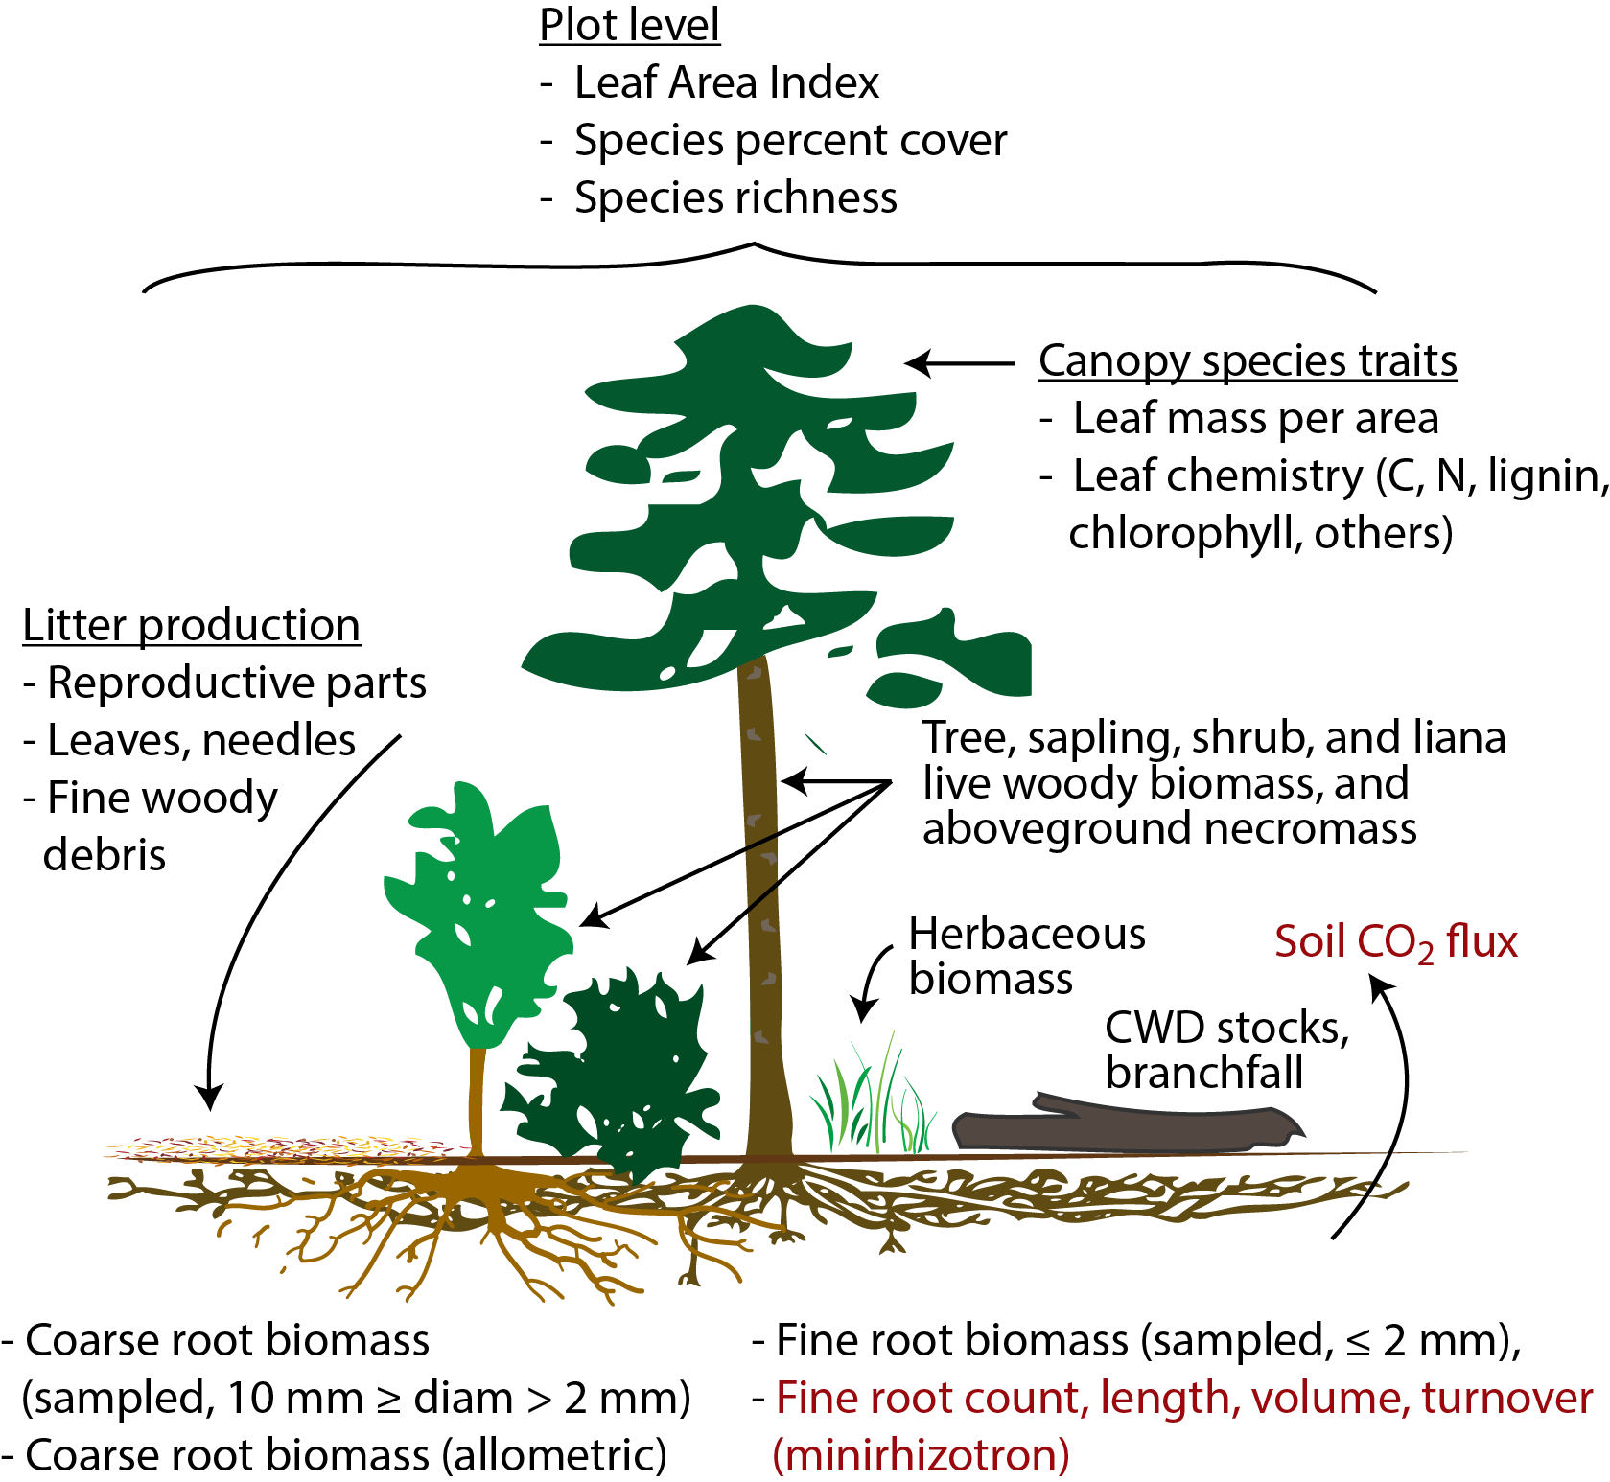
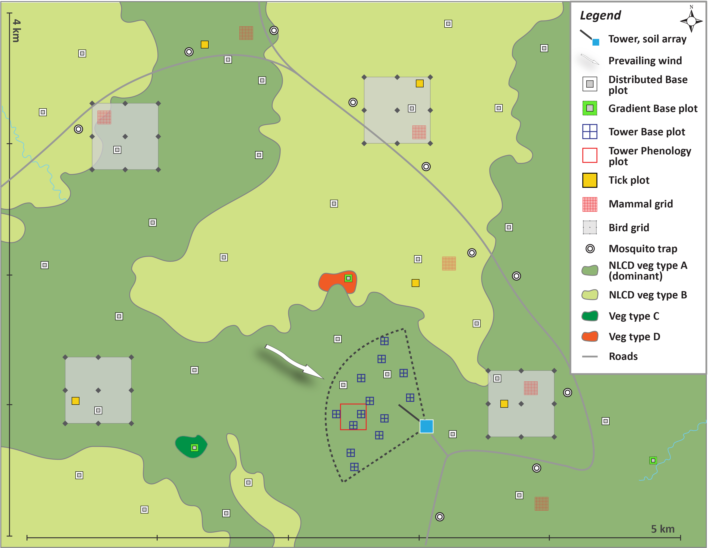
NEON plant biomass, productivity, and biogeochemistry design
Key foci of the sampling design supported by plot-based field measurements (black text), and by instrumentation (red text).
Biomass, productivity, and biogeochemistry data originate from Distributed, Gradient, and Tower Plots
Vegetation component | Sampling frequency | Spatial extent
Vegetation structure, woody stems | Annual (Tower plots) Every 3 y (Distributed/ Gradient plots) | Tower plots Distributed plots (max n=20) Gradient plots (if necessary)
Herbaceous plants | 1X-2X per year | Tower plots Distributed plots (max n=20) Chemistry every 5 y
Mat-forming bryophytes | Annual | Tower plots
Litter, fine woody debris | Every 8 wks; every 2 wk for deciduous in autumn | Tower plots; chemistry every 5 y
Coarse woody debris | Every 5 y | Tower plots Distributed Plots (max n=20)
Belowground biomass | Annual | Tower plots; chemistry every 5 y
Leaf area index | 2 weeks (Tower Plots) Every 5 y (Distributed/Gradient Plots) | Tower plots (n=3) Distributed plots (max n=20) Gradient plots (if necessary)
Chemical measurements of sun-lit foliage
(*applies to litter and roots)
Measurement | Frequency
Total C* | Every 5 y
Total N* | Every 5 y
Total S | Every 5 y
Total P | Every 5 y
δ13C* | Every 5 y
δ15N* | Every 5 y
Chlorophyll | Every 5 y
Lignin | Every 5 y
Cations | Every 5 y

